Slide 1
2011 Fleet Behavior to SSL Interim Final Rule
SSL Mitigation Committee Meeting
July 16-17, 2012

Slide 2
Primary Topics
Atka Mackerel Fishery
Trawl Pacific cod
Trawl CP
Trawl CV
Non-Trawl Pacific cod
Re-initiation Triggers
Non RPA effects

Slide 3
2010 Atka Mackerel Catch by Week and Area
Metric Tons of Atka Mackerel
Source: 2010 Inseason Management Annual Report
Notes:
3

Slide 4
2011 Atka Mackerel Catch by Week and Area
Season dates for Atka Mackerel relaxed and HLA eliminated
Metric Tons of Atka Mackerel
Jan-11
Source: 2011 Inseason Management Annual Report
Notes:
4
EBS 541 Sept 1 allocation taken incidentally throughout the summer. No directed fishery. T

Slide 5
2004-2011 Atka Mackerel Weekly Catch rate
Metric Tons of Atka Mackerel
Notes:
5
EBS 541 Sept 1 allocation taken incidentally throughout the summer. No directed fishery. T

Slide 6
Western AI (543) Atka Mackerel Total Catch
No retention of Atka Mackerel
Establish a TAC sufficient to support the incidental catch
Total incidental catch was 206 mt, 11 mt was inside Critical habitat. All incidental catch was in the Rockfish target or POP .

Slide 7
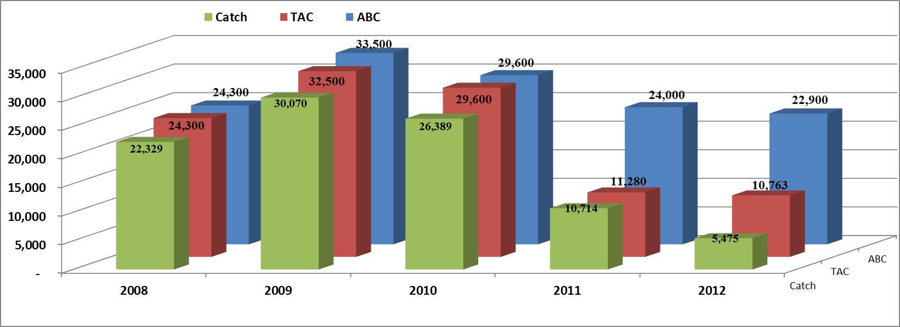
Central AI (542) Atka Mackerel Total Catch
Set TAC for Area 542 to no more than 47 percent of the acceptable biological catch (ABC).
Catch Concentrated on the Petrel Banks
*2012 current to 7/1/2012

Slide 8
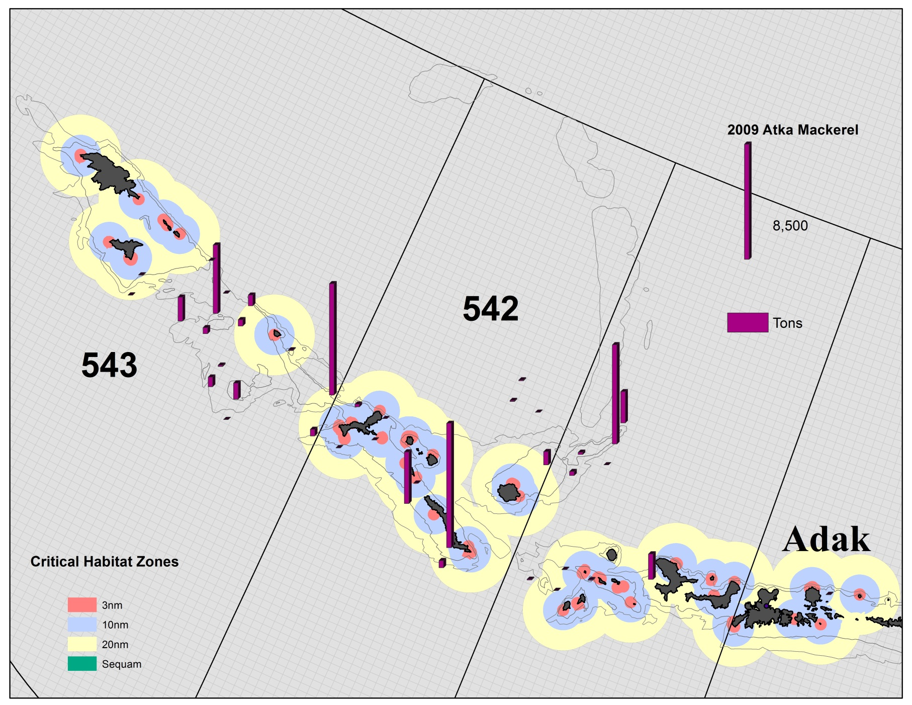
2009 Atka Mackerel Catch in 542/543

Slide 9
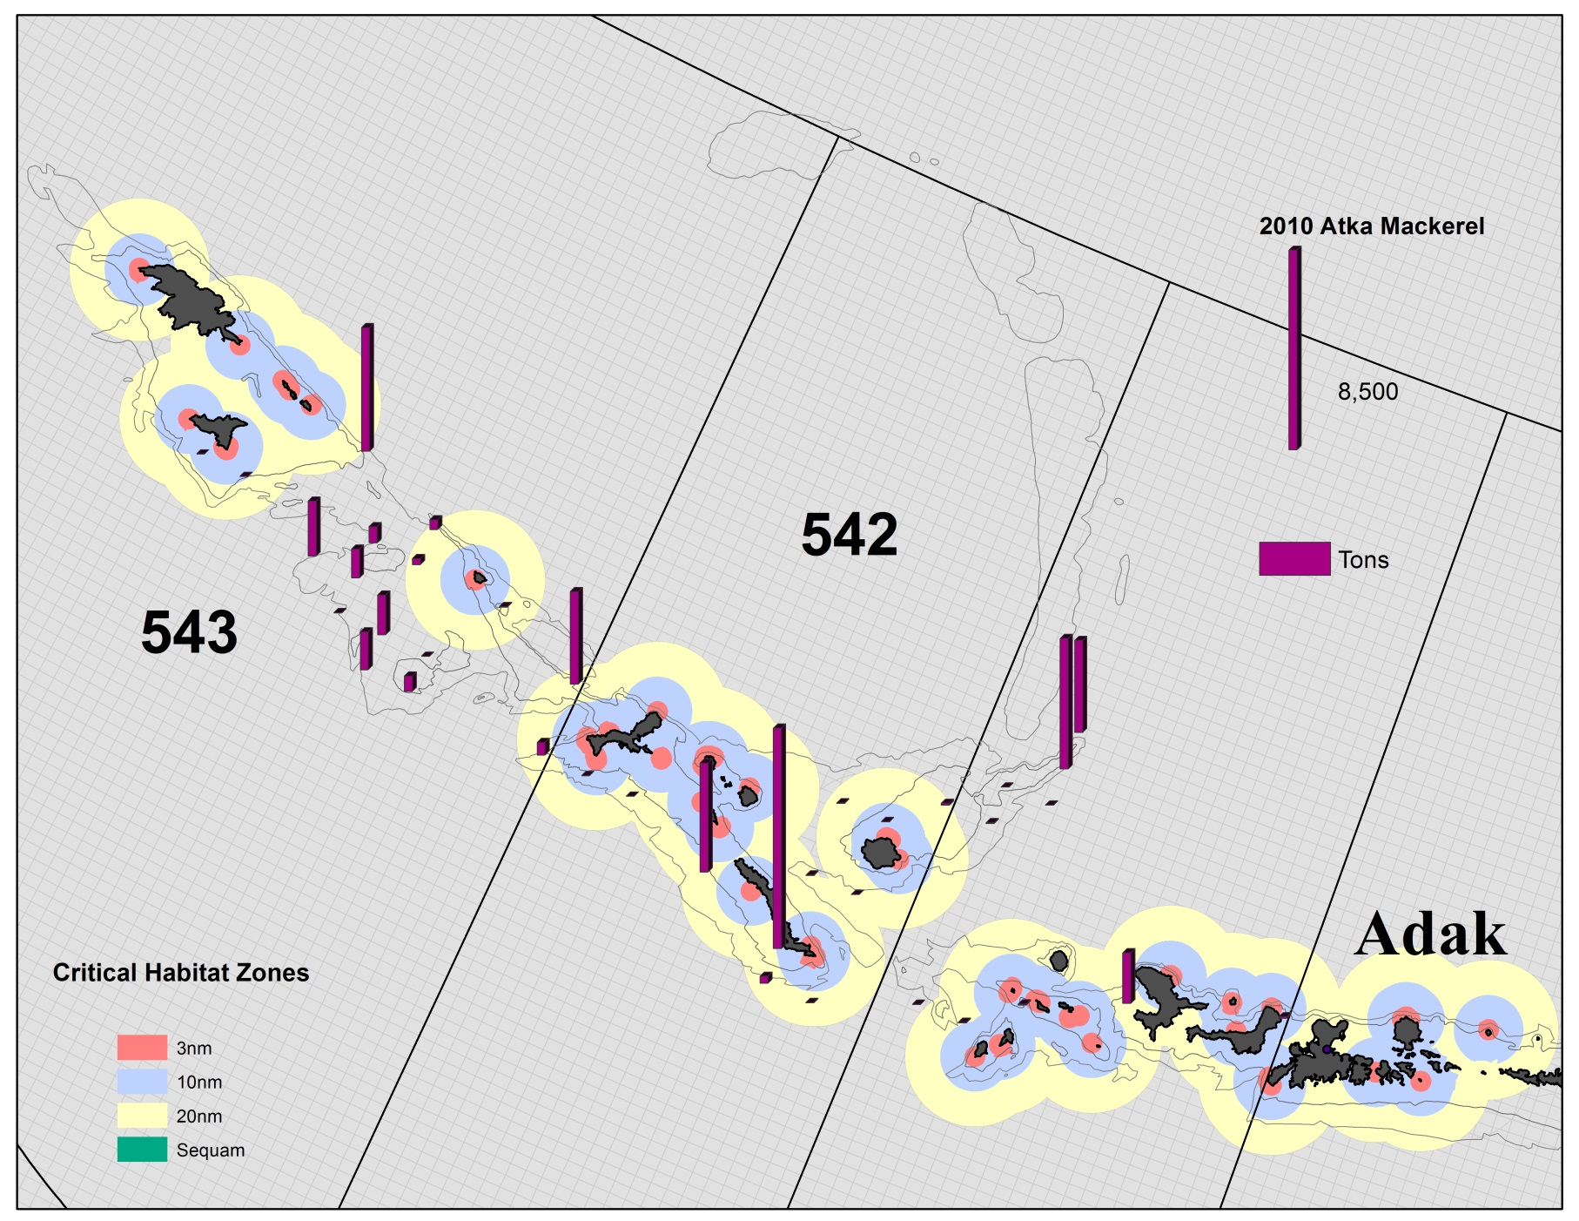
2010 Atka Mackerel Catch in 542/543

Slide 10
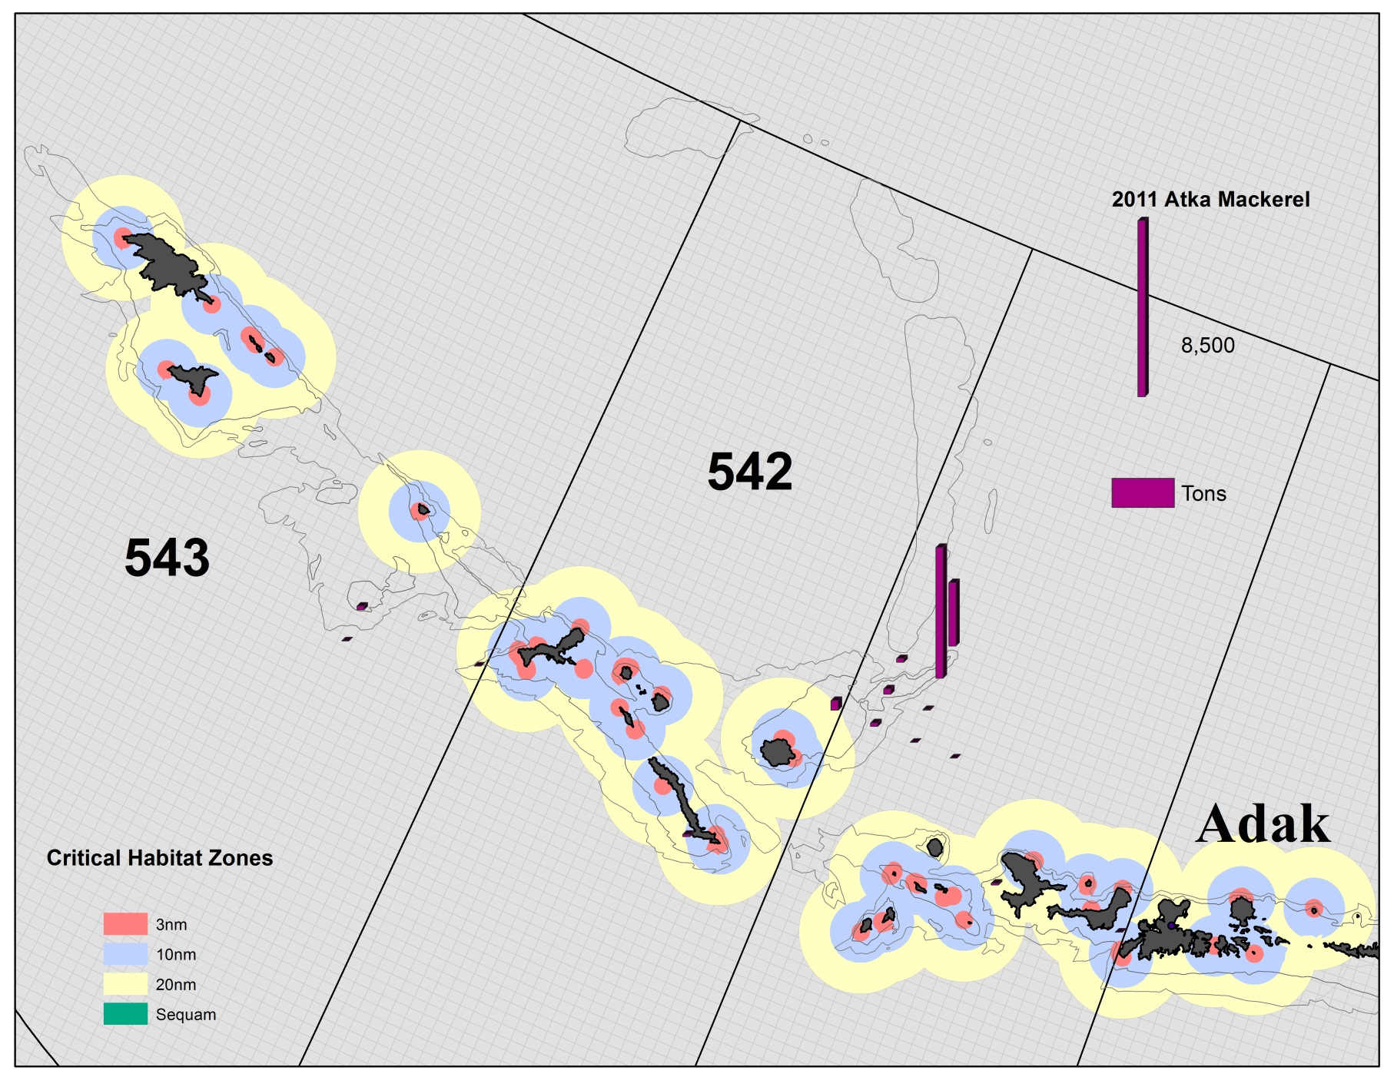
2011 Atka Mackerel Catch in 542/543

Slide 11
Central AI (542) Atka Mackerel Critical Habitat
Critical habitat from 0–20 nm closed to directed fishing for Atka mackerel, except between 179 W to 178 W longitude where only 10-20 nm is open to CDQ and Amendment 80 coop vessels.
Limit the amount of Atka mackerel harvest allowed inside critical habitat to no more than 10 percent of the annual allocation.

Slide 12
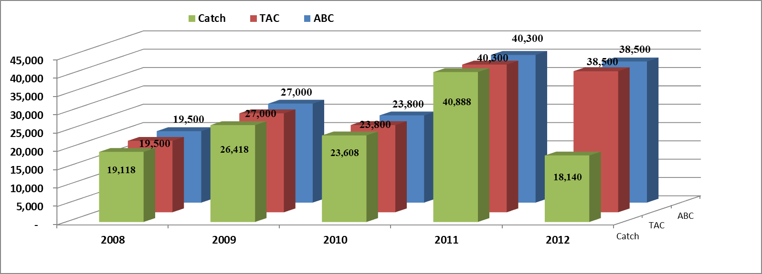
Eastern AI / Bering Sea Atka Mackerel Total Catch
Eastern Shift of Atka Mackerel TAC
Higher incidental catch of Atka Mackerel in the Bering Sea by pollock fleet
*2012 current to 7/1/2012

Slide 13
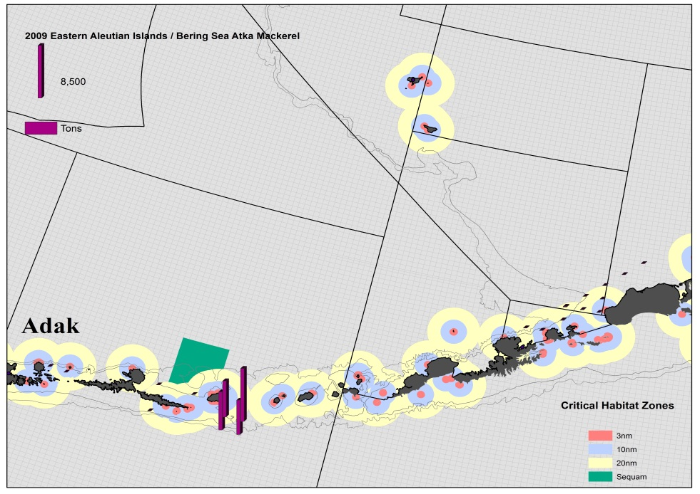
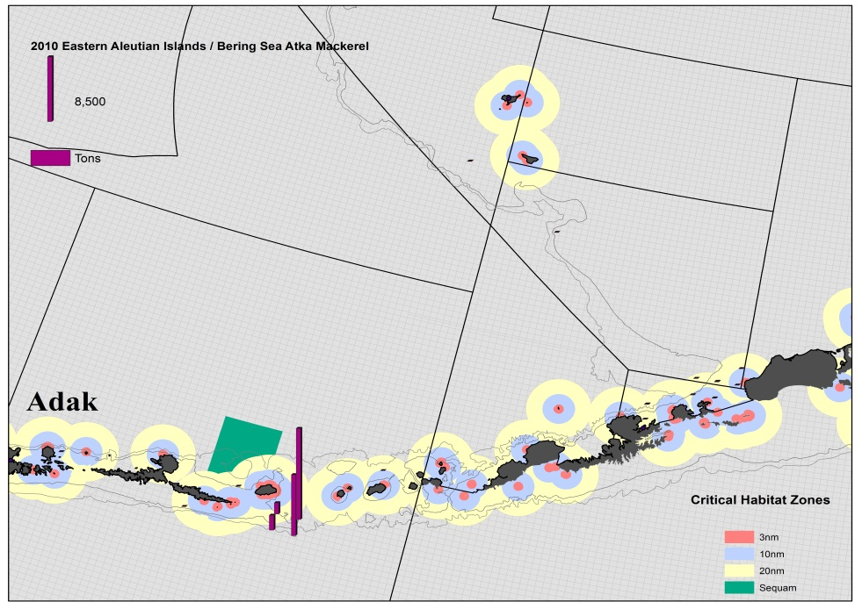
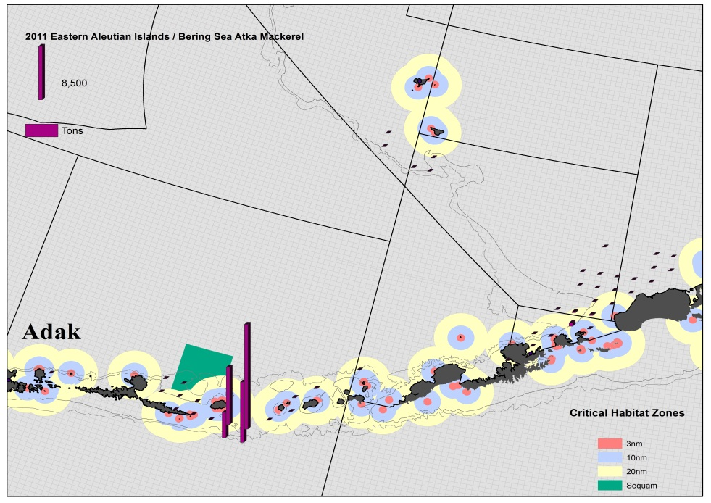
2009 - 2011 Atka Mackerel Catch in 541 / EBS

Slide 14
Pacific cod

Slide 15
Trawl Gear Pacific cod Restrictions
543 closed to Pacific cod (PSC)
0-20 nm Critical habitat (CH) in 542 closed year round west of 178 W longitude
0-10 nm CH in 542 closed year round east of 178 W longitude
0-10 nm CH in 541 closed year round
Seasonal closures
Jan 1 – Jan 20; Trawl gear closed in BSAI
Jan 20 – Jun 10; 10-20 nm CH open in 542 East of 178 W longitude, 10-20 nm CH open in 541, Outside CH open
Jun 10 – Nov 1; 0-20 nm CH closed in both 541 and 542
Nov 1- Dec 31; Trawl gear for Pacific cod closed in BSAI

Slide 16
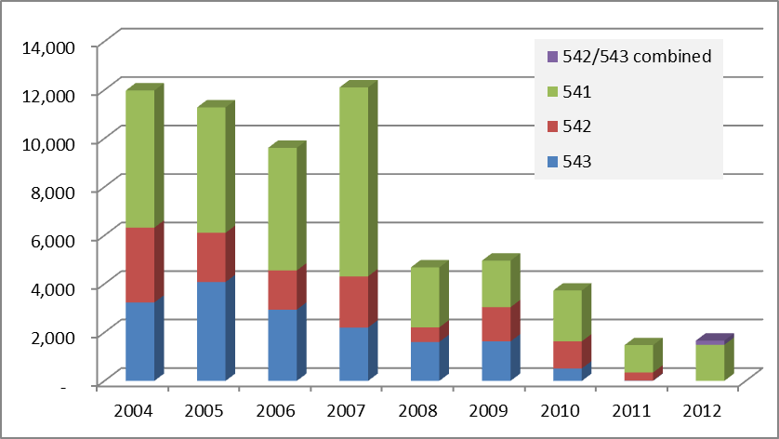
Trawl Catcher Processor Pacific Cod

Slide 17
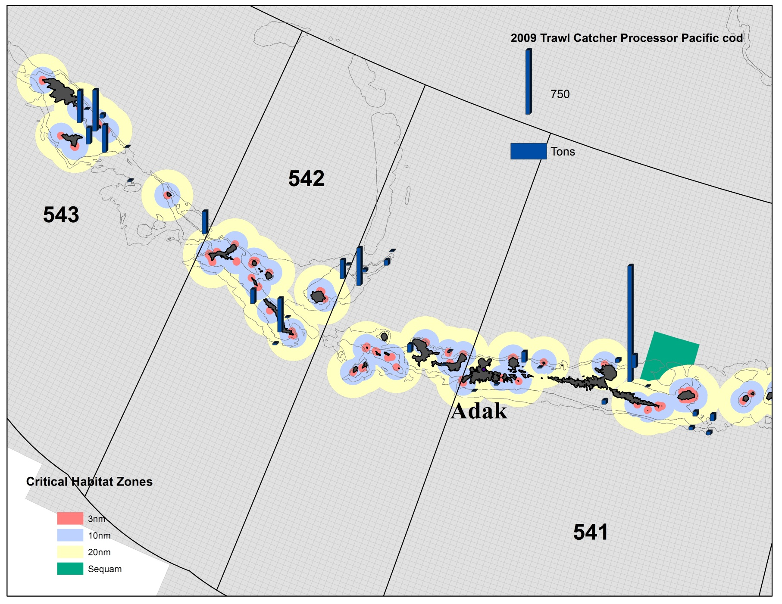
2009 Trawl Catcher Processor
Pacific cod Catch in The Aleutian Islands

Slide 18
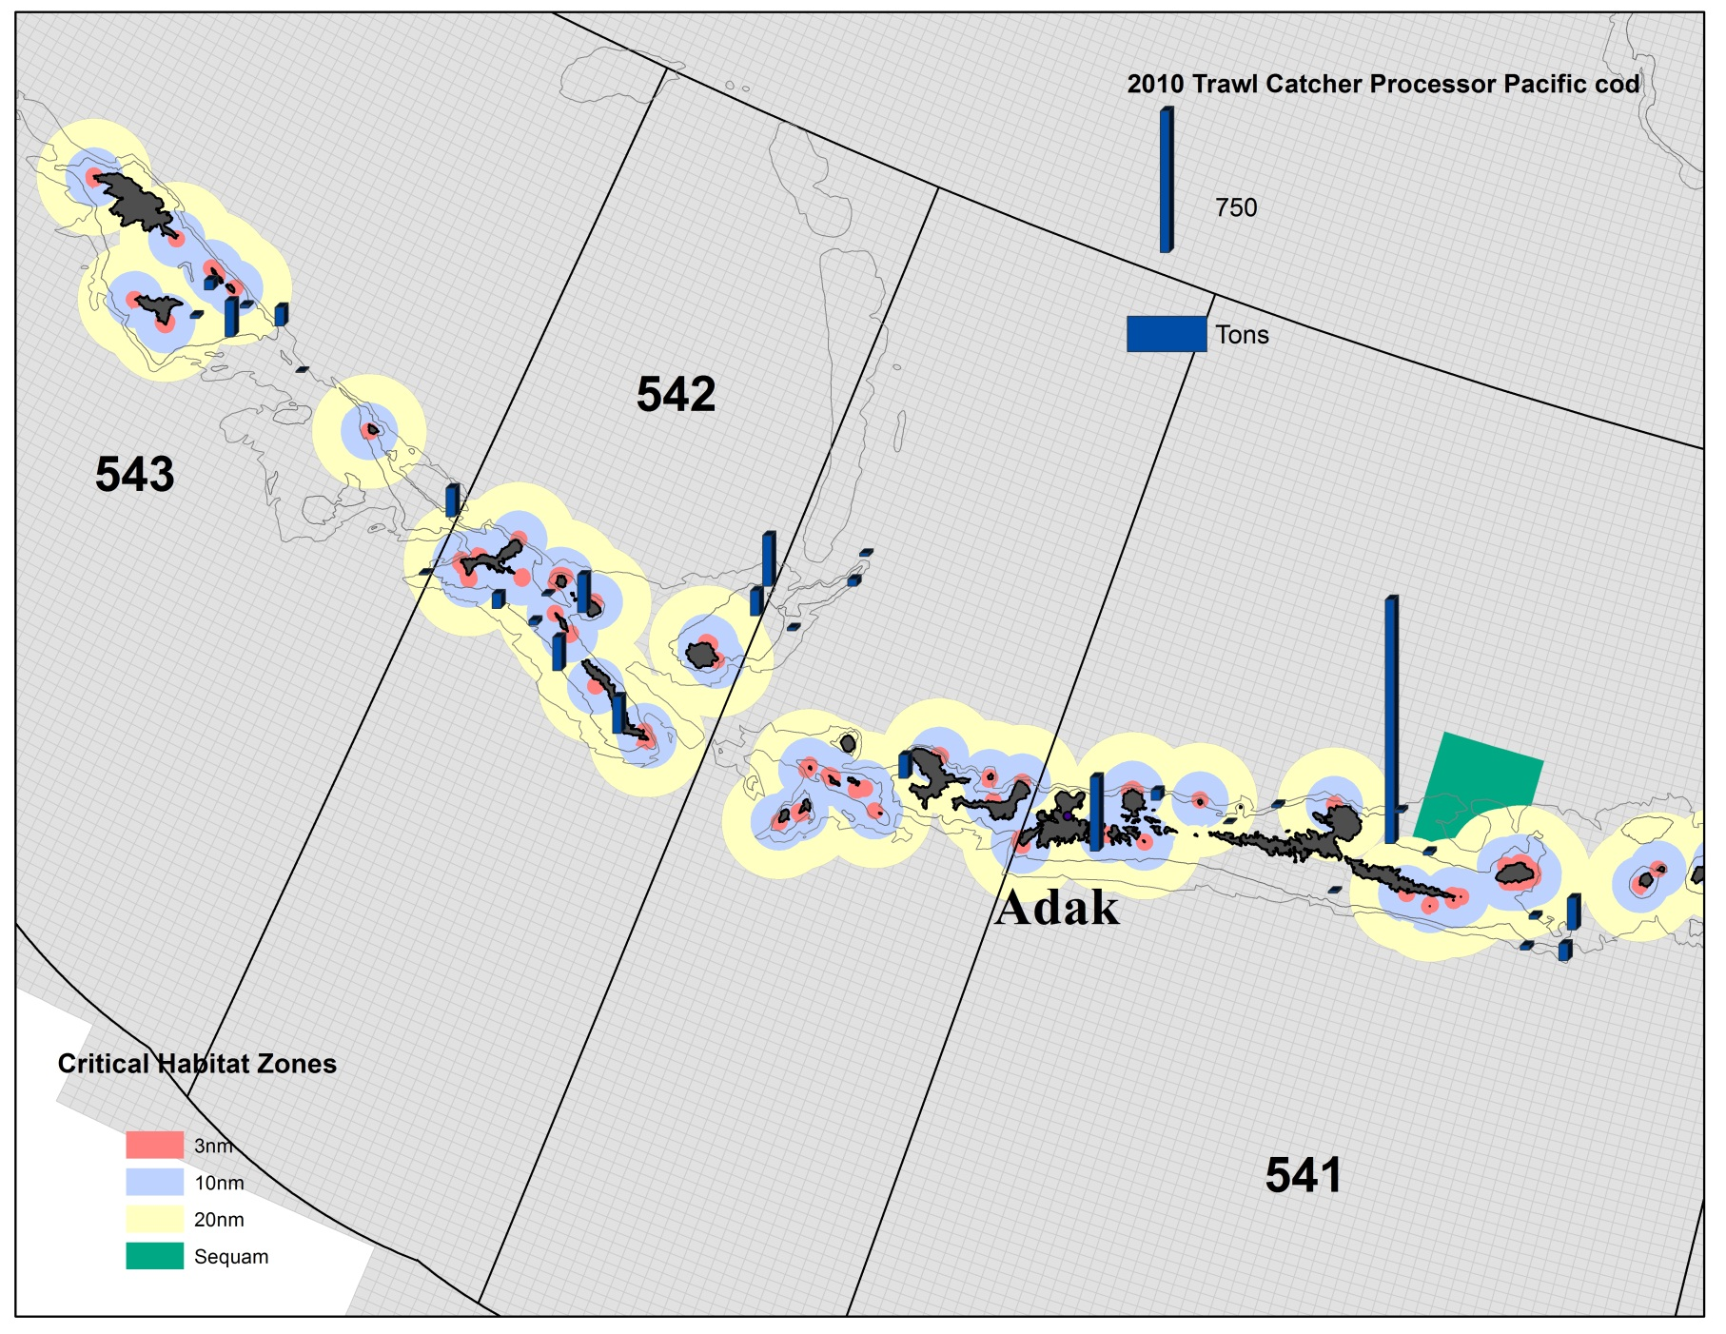
2010 Trawl Catcher Processor
Pacific cod Catch in The Aleutian Islands

Slide 19
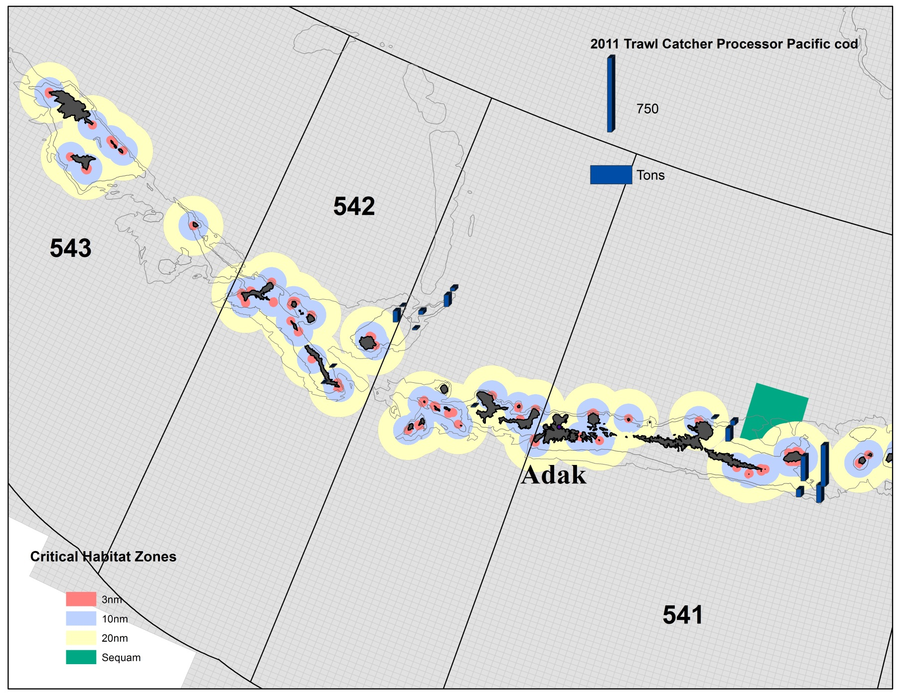
2011 Trawl Catcher Processor
Pacific cod Catch in The Aleutian Islands

Slide 20
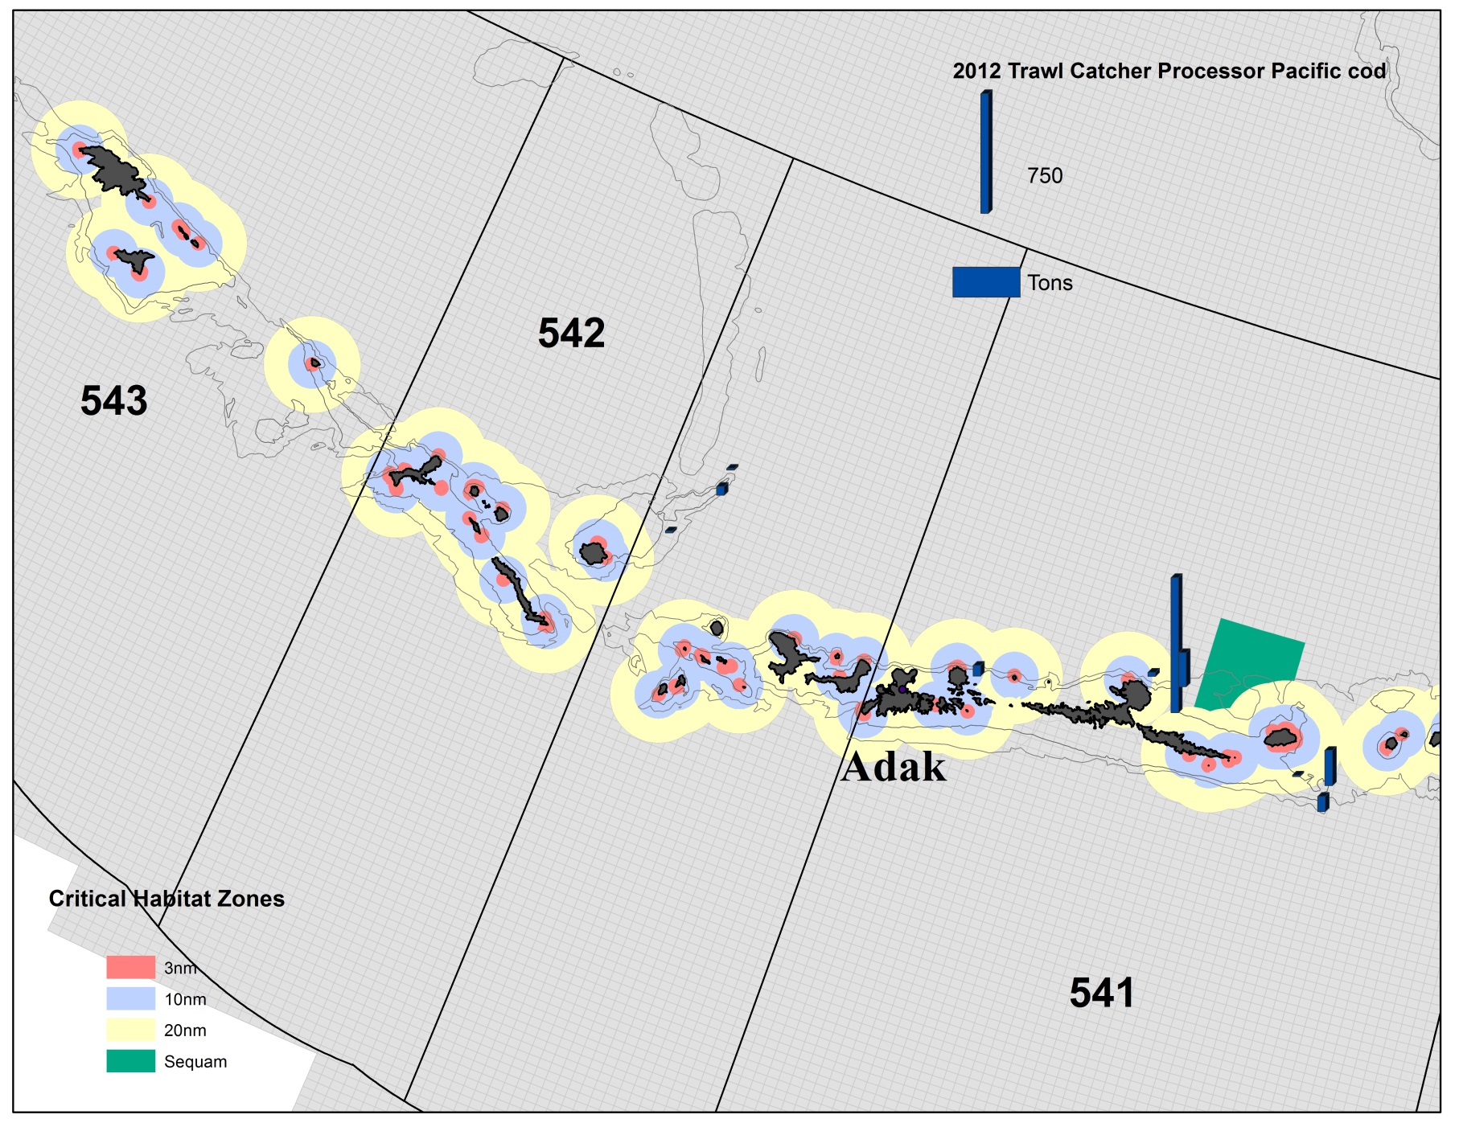
2012 Trawl Catcher Processor
Pacific cod Catch in The Aleutian Islands

Slide 21
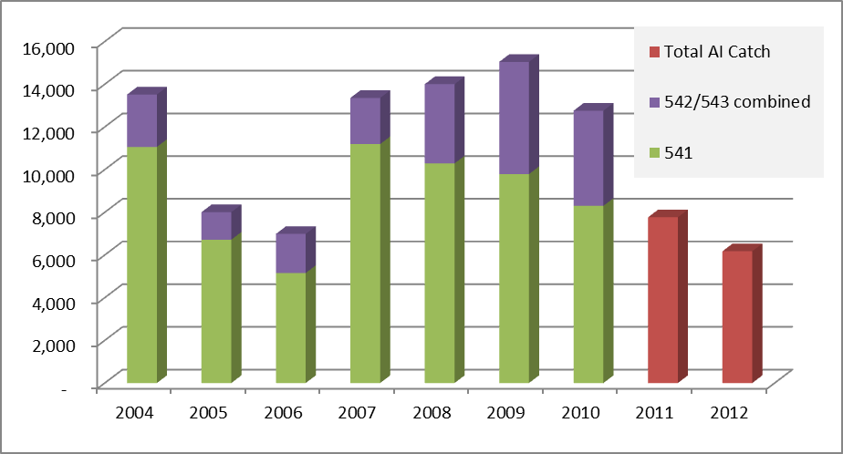
Trawl Catcher Vessel Pacific Cod

Slide 22
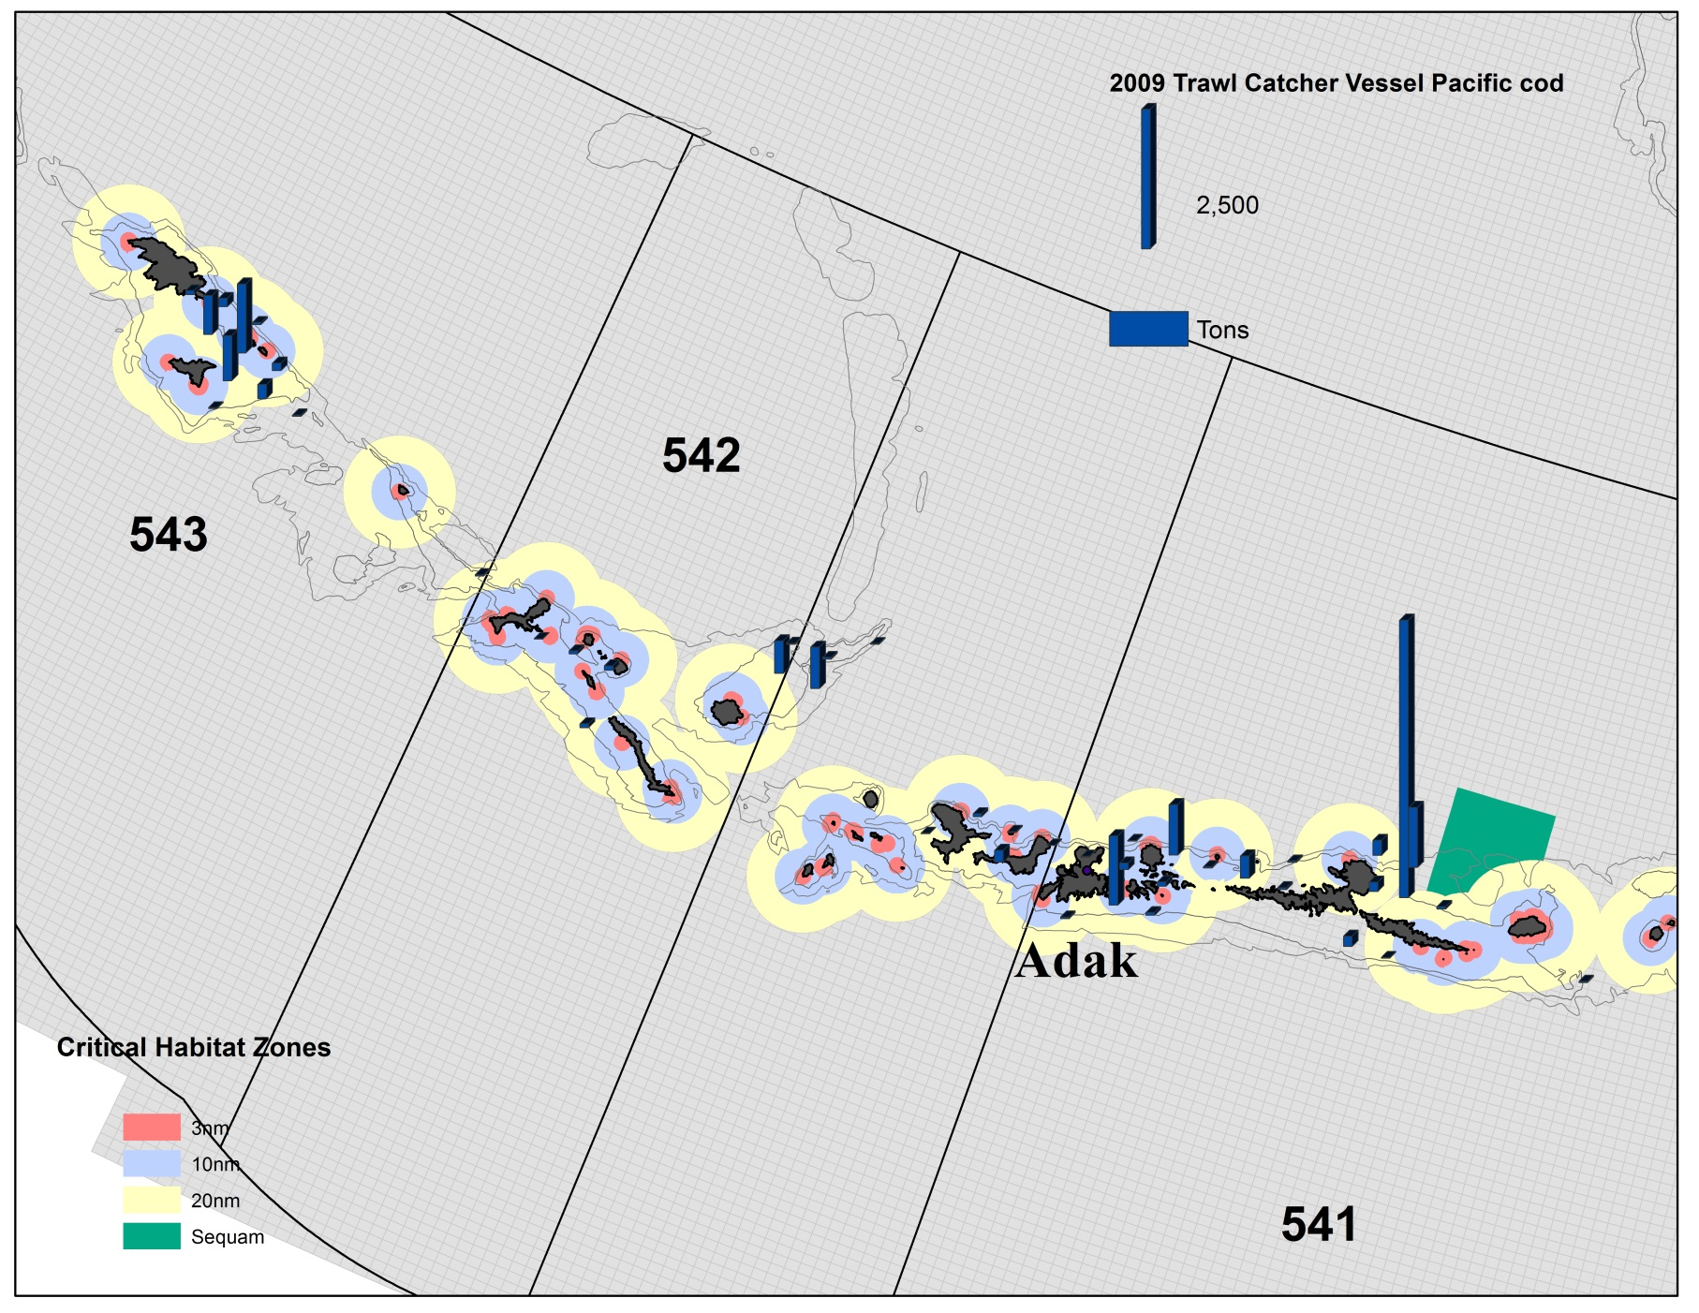
2009 Trawl Catcher Vessel
Pacific cod Catch in The Aleutian Islands

Slide 23

2010 Trawl Catcher Vessel
Pacific cod Catch in The Aleutian Islands

Slide 24
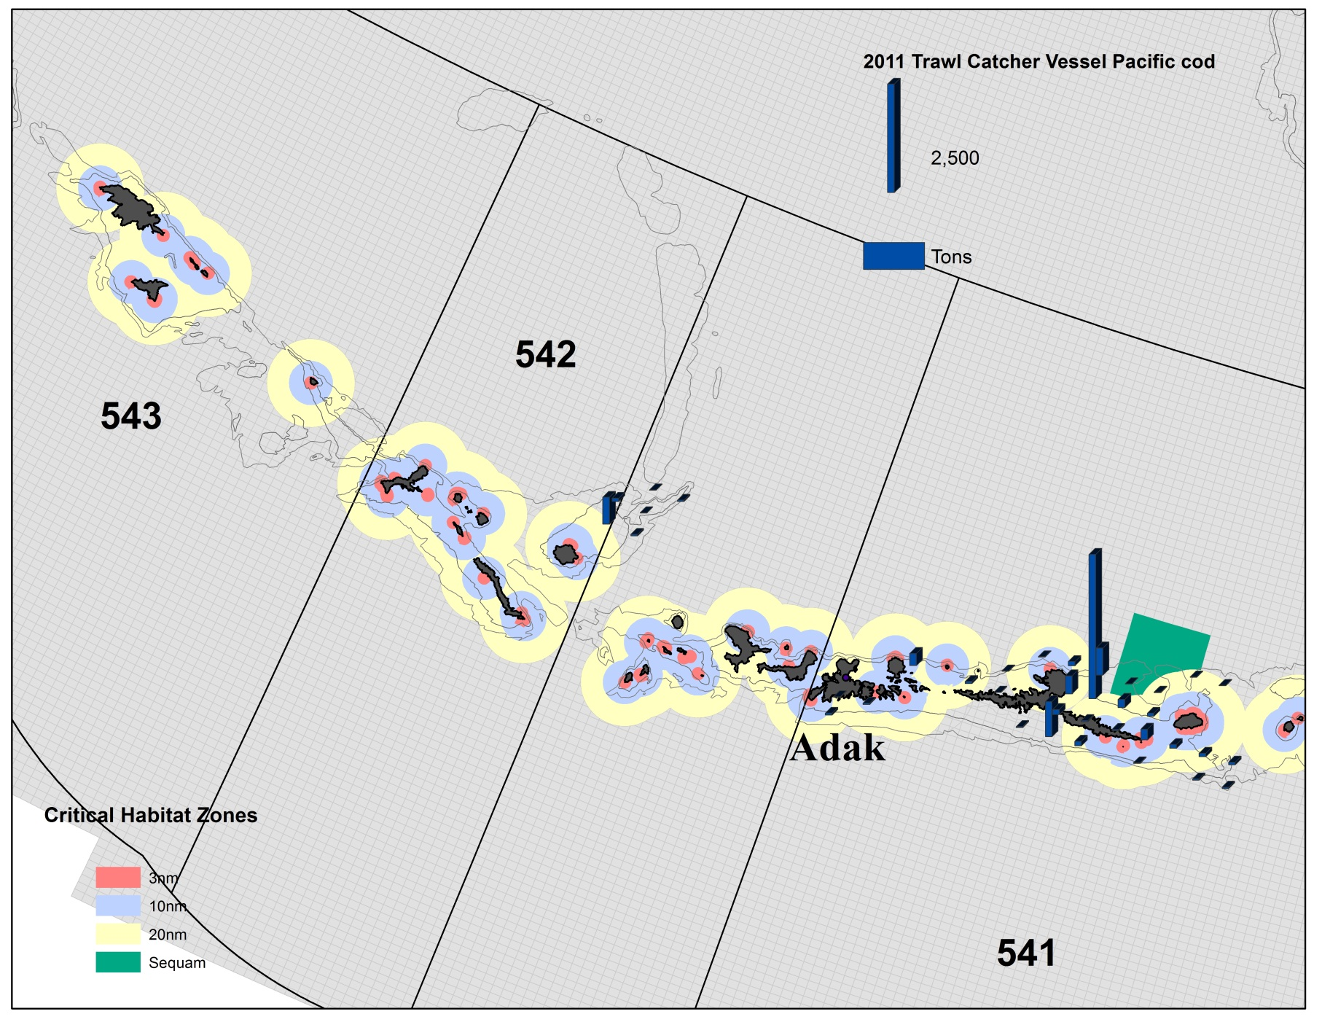
2011 Trawl Catcher Vessel
Pacific cod Catch in The Aleutian Islands

Slide 25
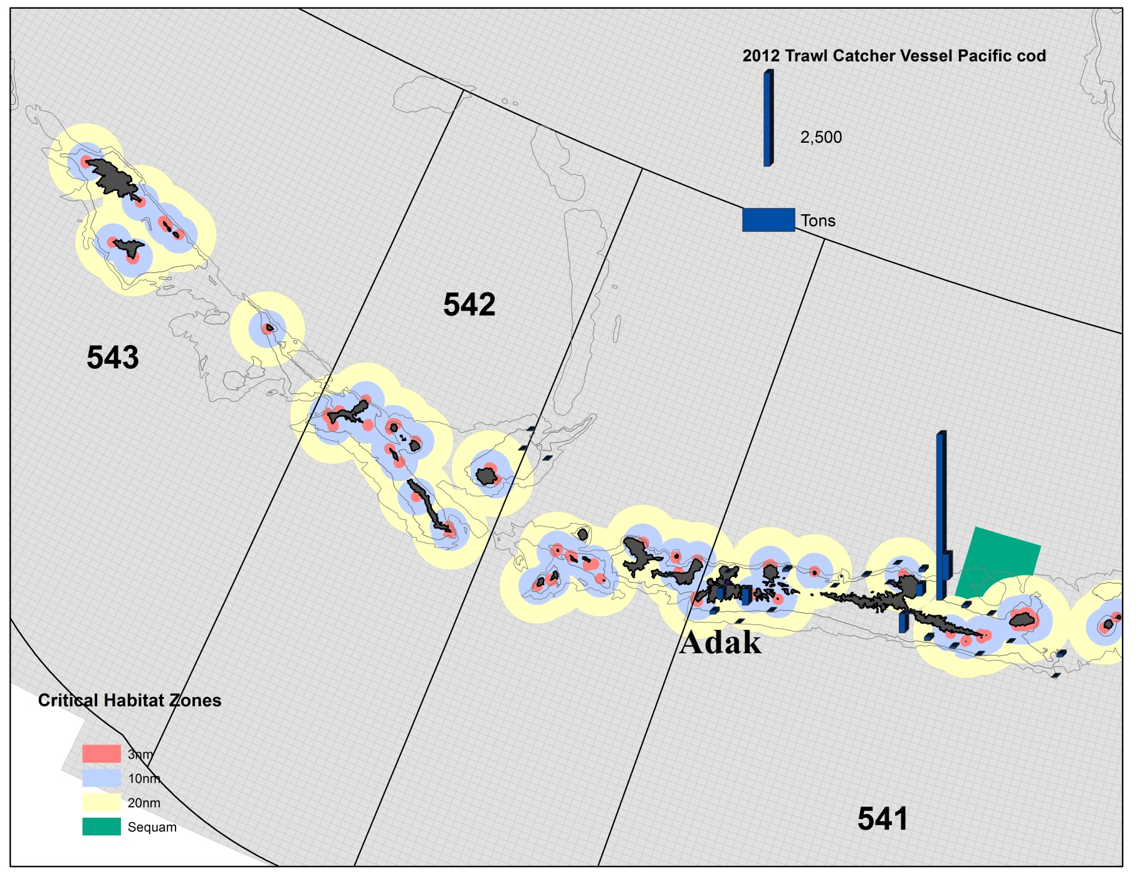
2012 Trawl Catcher Vessel
Pacific cod Catch in The Aleutian Islands

Slide 26
Non-Trawl Gear Pacific cod Restrictions
543 closed to Pacific cod (PSC)
0-6 nm Critical habitat in 542 closed year round
0-10 nm Critical habitat in 541 closed year round
Seasonal closures
Jan 1 – March 1; No fishing inside 0-20 nm Critical habitat, Outside Critical habitat open
Mar 1 – Nov 1; 6-20 Critical habitat open in 542, 10-20 nm open in 541, Outside Critical habitat open
Nov 1- Dec 31; No fishing in 541 and 542

Slide 27
Non-Trawl Catcher Processor Pacific Cod

Slide 28
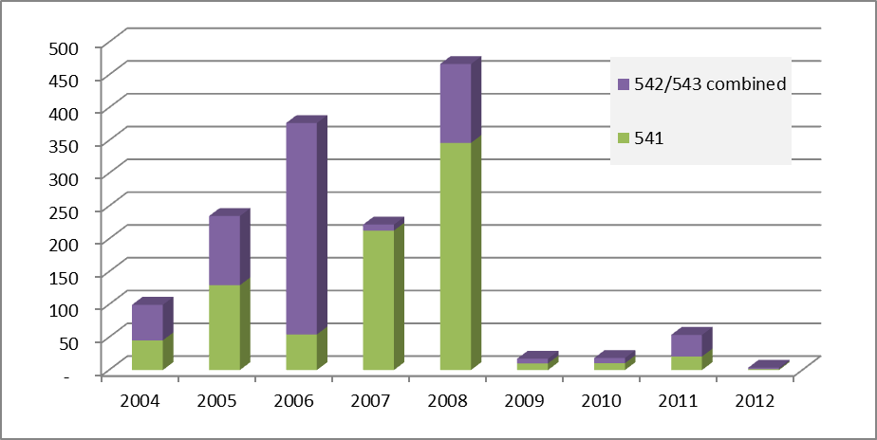
Non-Trawl Catcher Vessel Pacific Cod

Slide 29
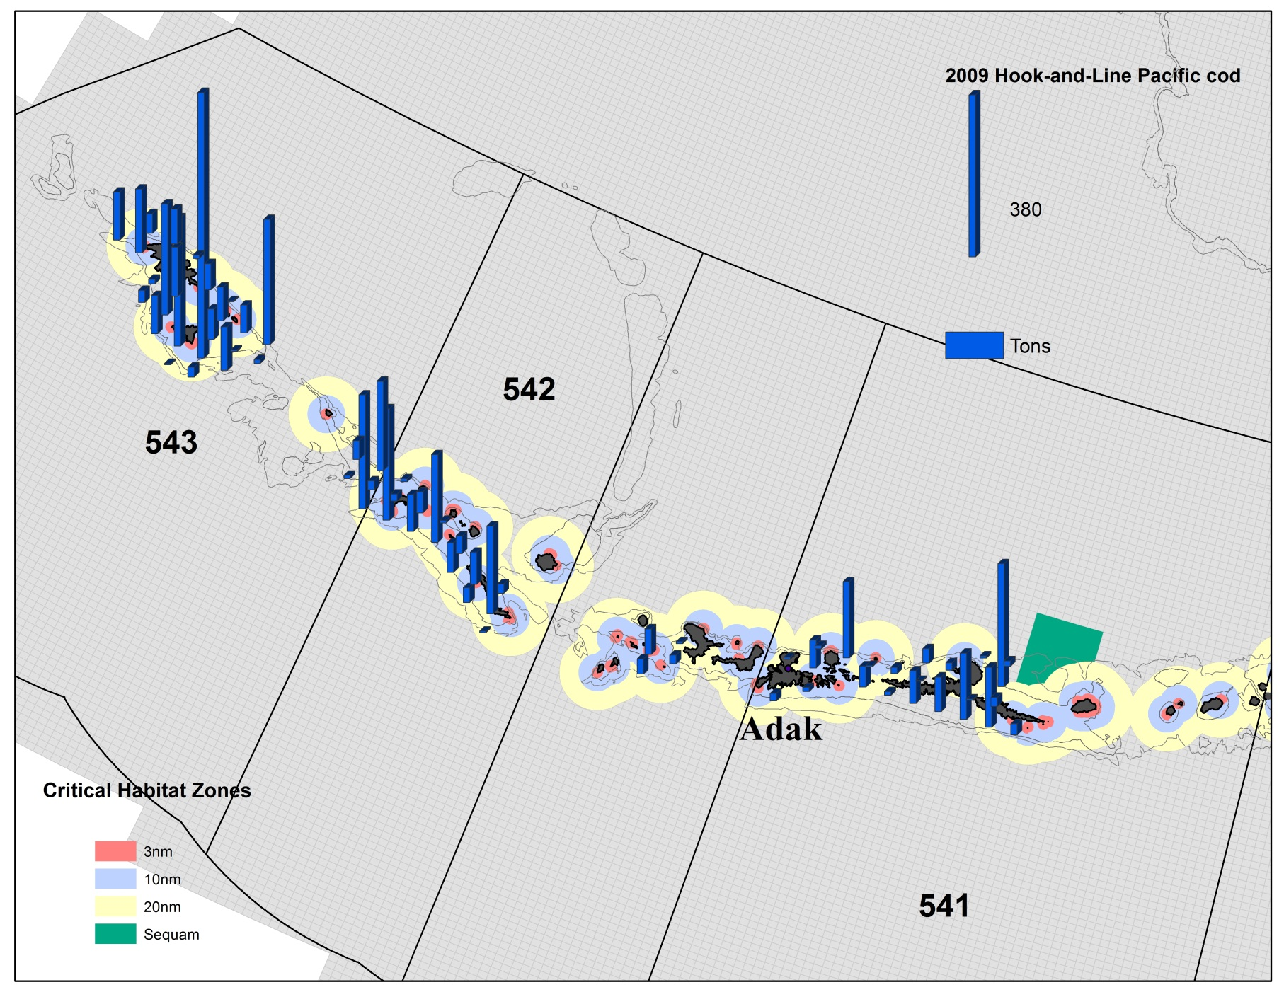
2009 Non-Trawl Pacific cod Catch in The Aleutian Islands

Slide 30
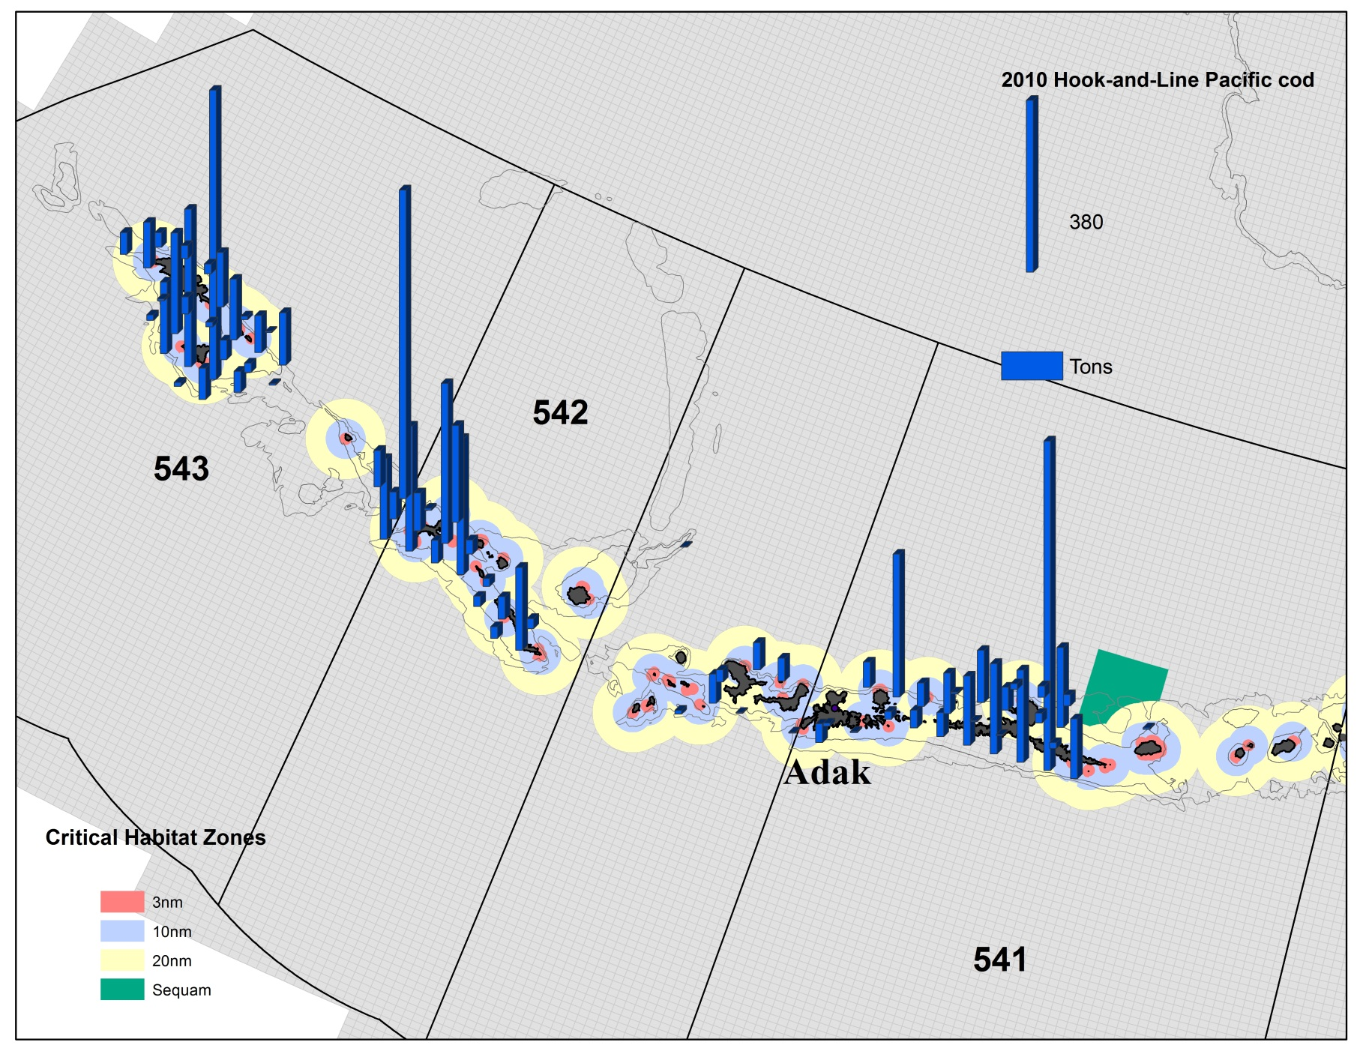
2010 Non-Trawl Pacific cod Catch in The Aleutian Islands

Slide 31
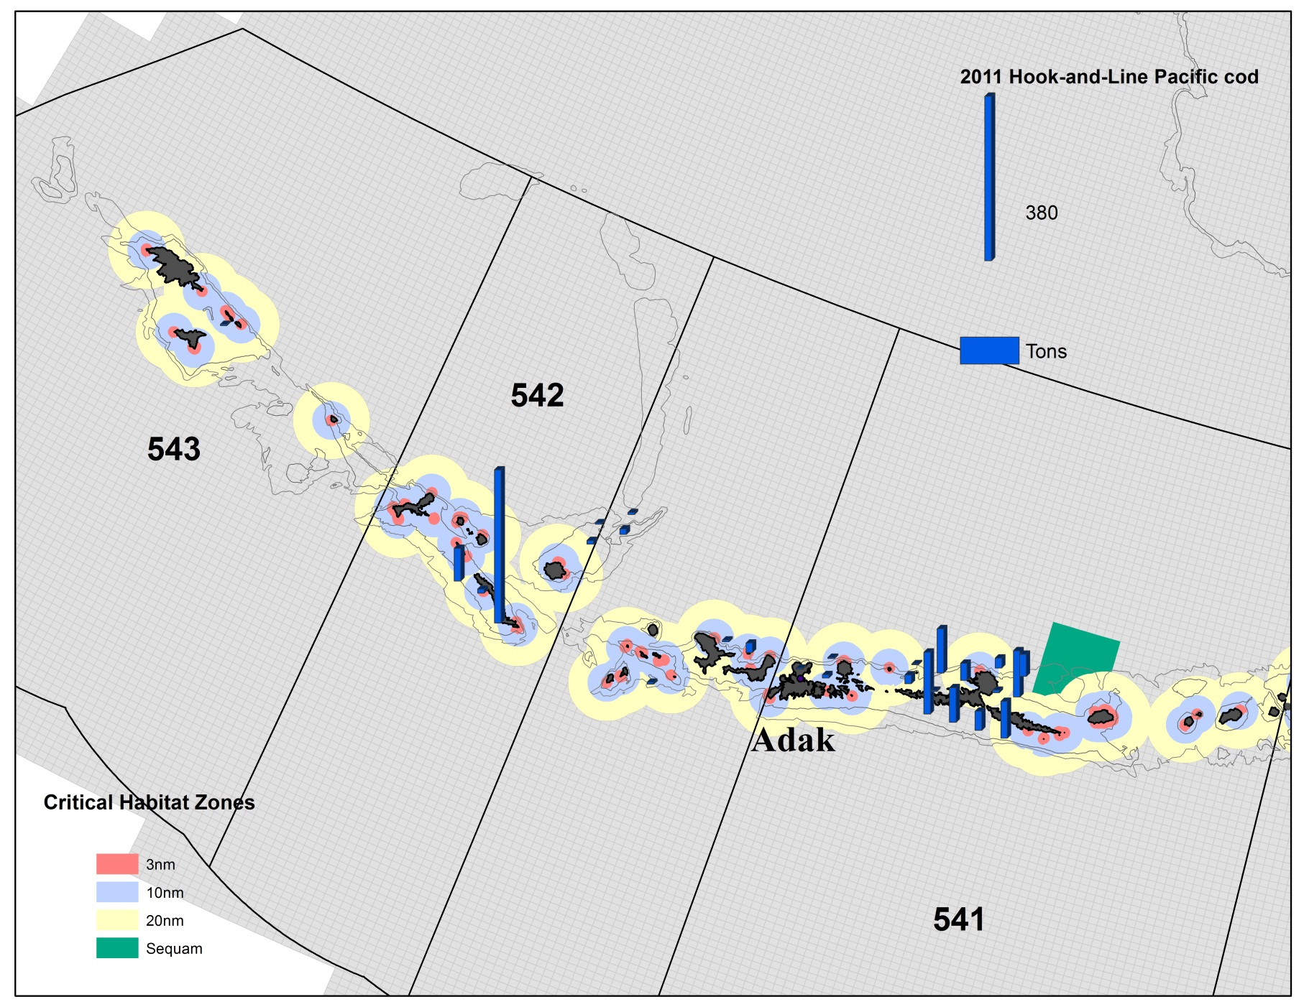
2011 Non-Trawl Pacific cod Catch in The Aleutian Islands

Slide 32
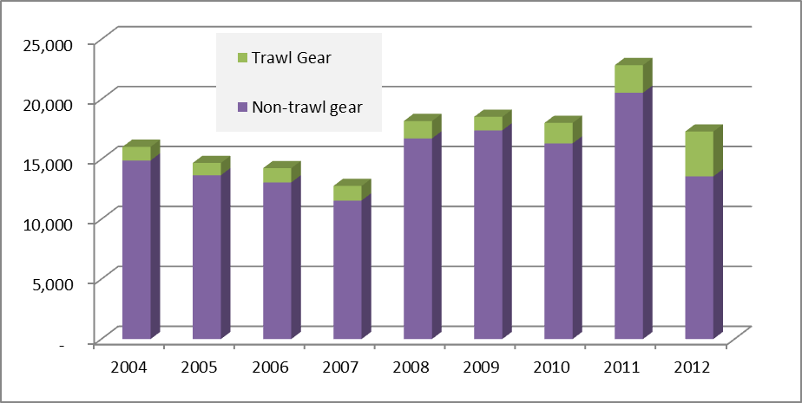
BSAI CDQ Pacific Cod

Slide 33
Non SSL RPA effects on
AI Pacific cod fisheries
Anecdotal evidence suggested that there were larger than average Pacific cod in the Bering sea in 2011 and 2012.
Large increases of the BSAI Pacific cod ABC in recent years; 35% increase in 2011
Catch rates and effort in the Bering sea above average in A seasons of 2011 and 2012.
Freezer Longline Coop formed in August of 2010 that removes the race for fish among hook-and-line catcher processors
Shoreside processor problems in Adak in A season of 2010 and no operating processor in the first half of 2011
Ice edge extent of 2012
Tsunami in Japan

Slide 34
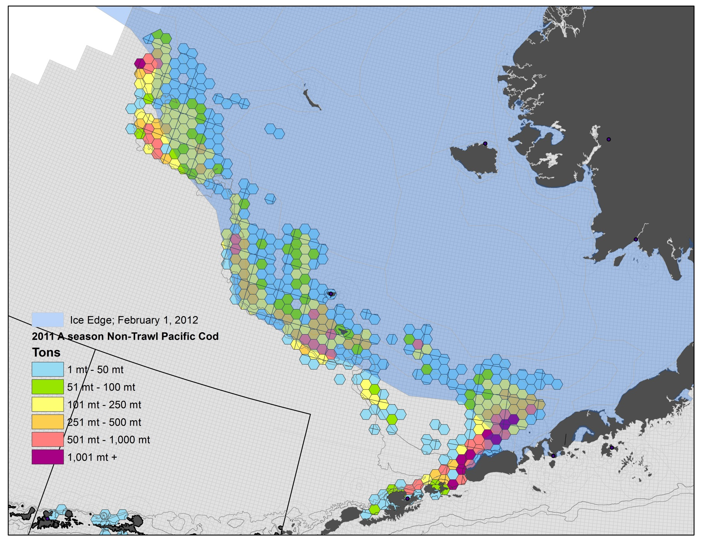
2012 Ice edge effects on
Non-trawl Pacific cod fisheries

Slide 35
Pacific Cod Re-initiation Triggers
Pacific cod in Area 542
Non-trawl exceeds 1.5% of the BSAI Pacific cod ABC
Trawl exceeds 2.0% of the BSAI Pacific cod ABC
Pacific cod in Area 541
Non-trawl exceeds 1.5% of the BSAI Pacific cod ABC
Trawl exceeds 11.25% of the BSAI Pacific cod ABC

